Slide 1
Refining Your Project Schedule
Microsoft Project 2016
Lesson 4

Slide 2
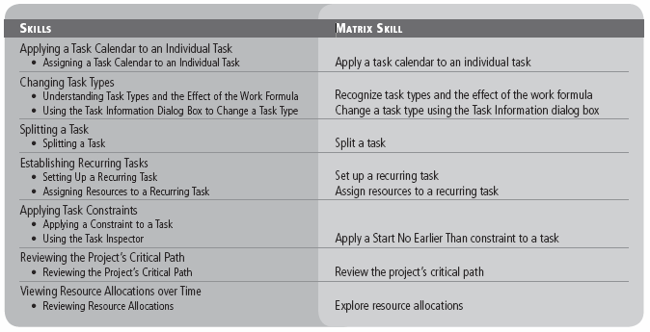
Objectives

Slide 3
Software Orientation
In Project 2016, you might want specific tasks to occur at times that are outside the project calendar’s working time.
To do this, you need to create a new base calendar, a feature that is accessed through the Change Working Time dialog box, shown in the figure on the next slide.
This dialog box is accessed by clicking the Create New Calendar button in the Change Working Time dialog box, located on the Project ribbon.
The Create New Base Calendar dialog box enables you to name the new calendar, create a totally new calendar, or make a copy of an existing calendar on which to base your new calendar.

Slide 4
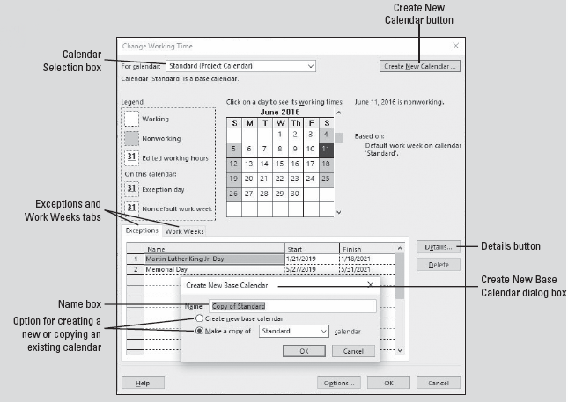
Software Orientation
Notes:
Change Working Time dialog box, with Create New Base Calendar dialog box open

Slide 5
Applying a Task Calendar to an Individual Task
When you set up resources in your project schedule, Microsoft Project created a specific calendar for each work resource. Each resource calendar is based on another calendar, usually the project calendar.
Sometimes, you need a specific task to occur at a time that is outside the project calendar’s working time (such as overnight or on a weekend).
To do this, you can assign a task calendar to this task. You can use one of Project’s base calendars, or you can create a new base calendar that fits your task requirements.

Slide 6
Assigning a Task Calendar to an Individual Task
A task calendar is a base calendar used by a single task for scheduling. It defines working and nonworking times for a task, regardless of settings in the project calendar.
Task calendars are often used when a task must run overnight, occur on a specific weekday, or occur over a weekend.
Task calendars are beneficial when other base calendars—such as the 24 Hours or Night Shift—are too broad or too specific for the task requirements.
In the following exercise, you will create and assign a task calendar to a task that occurs outside normal working times—an overnight video shoot.

Slide 7
Step-by-Step: Apply a Task Calendar to an Individual Task
GET READY. Before you begin these steps, OPEN Tailspin Remote Drone 4M from the data files for this lesson. SAVE the file as Tailspin Remote Drone 4 in the solutions folder.
Click the Project tab and then click Change Working Time. The Change Working Time dialog box appears.
In the Change Working Time dialog box, click the Create New Calendar button. The Create New Base Calendar dialog box appears, as shown in the figure on the next slide.
In the Name box, key Survey Calendar. When the survey team is out interviewing people, they will work different hours than the rest of the team as well as Saturdays.

Slide 8
Step-by-Step: Apply a Task Calendar to an Individual Task
Notes:
Change Working Time dialog box, with Create New Base Calendar dialog box open

Slide 9
Step-by-Step: Apply a Task Calendar to an Individual Task
If it is not already selected, click the Make a copy of button. In the drop‐down menu, select Standard, and then click OK.
Click the Work Weeks tab, and then click the Details button. The Details dialog box appears.
In the Select day(s): box, drag your pointer to select Monday through Friday. Click the Set day(s) to these specific working times: radio button.
Click the cell in row 1 of the From column and key 10:00 AM. Click the cell in row 1 of the To column and key 2:00 PM. Click the cell in row 2 of the From column and key 3:00 PM. Click the cell in row 2 of the To column and key 7:00 PM. Press Enter. Your screen should look like the figure on the next slide.
Notes:
Take Note: Note that you are now editing the newly created base calendar called “Survey Calendar,” as indicated at the top of the dialog box, in the “For calendar:” box.

Slide 10
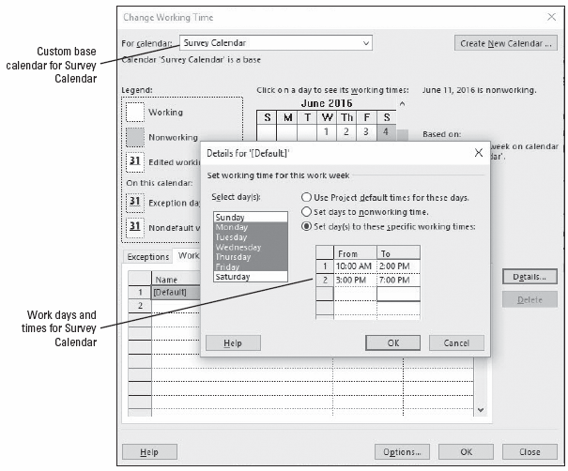
Step-by-Step: Apply a Task Calendar to an Individual Task
Notes:
Change Working Time and Details dialog boxes showing nonstandard working times

Slide 11
Step-by-Step: Apply a Task Calendar to an Individual Task
In the Select Days box, select Saturday. Click the Set day(s) to these specific working times button. Click the cell in row 1 of the From column and key 10:00 AM. Click the cell in row 1 of the To column and key 2:00 PM.
Click the cell in row 2 of the From column and key 3:00 PM. Click the cell in row 2 of the To column and key 7:00 PM. Press Enter.
Click OK to close the Details dialog box, and then click OK to close the Change Working Time dialog box. You have created and set the working times for this calendar from 10:00 AM to 7:00 PM from Monday through Saturday. Now, assign the calendar to a task.
Select the name of task 7, Conduct survey. If the Gantt bar of this task is not visible, click the Scroll To Task button on the Task ribbon.
Notes:
Take Note: Microsoft Project will not allow you to set a time frame that spans two days. For instance, you cannot specify a working time for Monday of 9 PM–3 AM because 3 AM is on Tuesday. You must set the time intervals for each specific day, and each new day begins at midnight.

Slide 12
Step-by-Step: Apply a Task Calendar to an Individual Task
Click the Task tab and then click the Information button in the Properties group. The Task Information dialog box appears.
Click the Advanced tab of the Task Information dialog box.
In the Calendar box, select Survey Calendar from the drop‐down list. Click the Scheduling ignores resource calendars check box. Your screen should look similar to the figure on the next slide.
Notes:
Another Way: To quickly bring information into view on a selected task, press the keystroke combination CTRL + SHIFT + F5.

Slide 13
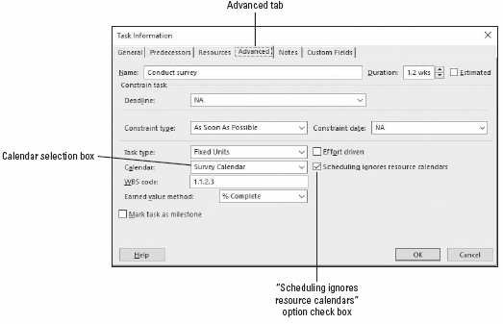
Step-by-Step: Apply a Task Calendar to an Individual Task
Notes:
The Advanced tab of the Task Information dialog box

Slide 14
Step-by-Step: Apply a Task Calendar to an Individual Task
Click OK to close the Task Information dialog box. Microsoft Project applies the Survey Calendar to task 7, and a calendar icon appears in the Indicators column. Because you chose to ignore resource calendars, the resources for this task will be scheduled at times that would usually be nonworking times.
SAVE the project schedule.
PAUSE. LEAVE the project schedule open to use in the next exercise.
For tasks that have both a task calendar and resource assignments (and therefore a resource calendar), Microsoft Project will schedule work in the working time that is common between the task and resource calendar(s). If there is no common time, Project will alert you when you assign a resource to the task or when you apply the task calendar.
Notes:
Take Note: You will notice that a small, red human icon appears in the Indicators column. This is a feature that notifies the user of a resource overallocation.

Slide 15
Changing Task Types
As you learned in Lesson 3, Microsoft Project uses the formula: Duration × Units = Work, called the work formula.
The task type specifies which value in the formula remains fixed if one of the other two values changes.
To determine which task type is the right one to apply to each task in your project schedule, you first need to determine how you want Project to schedule that task.
In the next exercise, you will examine the relationship between the work formula and task type.

Slide 16
Understanding Task Types and the Effect of the Work Formula
There are three task types: fixed units, fixed duration, and fixed work.
The default task type is fixed units, which means the units value does not change. With the fixed units task type, if you change a task’s duration, Microsoft Project recalculates work. If you change work, duration is recalculated.
A fixed duration task is one in which the duration value is fixed. If you change the task’s work or units value, Project recalculates the other value.
A fixed work task is one in which the work value is held constant. You can change the duration or units and Project will determine the other value.
Project has a bias toward changing duration first. If it cannot change Duration, it will change Work and then Units.

Slide 17
Step-by-Step: Change Values of the Work Formula
GET READY. USE the project schedule you created in the previous exercise.
Click the View tab. Click on the Task Usage button in the Task Views group on the ribbon. The Task Usage view (see the figure on the next slide) replaces the Gantt Chart view.
Press the F5 key. In the ID box, key 15 and then click OK. Microsoft Project shifts the project schedule so that task 15, Conduct observations, and its assignments are visible.
Auto‐fit the Task Name column and move the splitter bar to the right until you can see the Start column. To auto‐fit a column, place the pointer on the right side dividing line of the column name and double‐click.

Slide 18
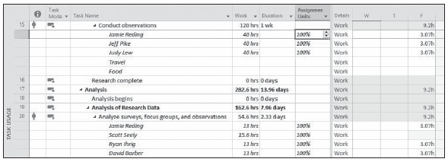
Step-by-Step: Change Values of the Work Formula
Right‐click on the Start column heading. Select Insert Column. You can search from the drop‐down list that appears for the field labeled Assignment Units. You can also start typing the word “assignment” and the list will be reduced in size. When the Assignment Units field appears, select it. Your screen should look like the figure below.
Notes:
Note that task 15 has a total work value of 120 hours (40 work hours per resource), 100 percent resource units for each of three resources, and duration of 1 week. Your team has determined that this task’s duration should be two weeks, but the work necessary to complete the task should remain the same.

Slide 19
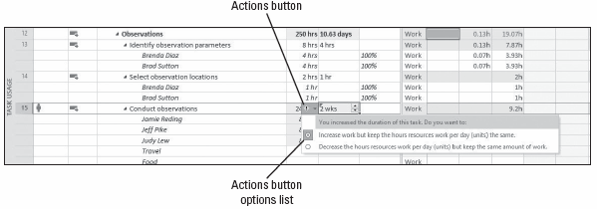
Step-by-Step: Change Values of the Work Formula
In the Duration field for task 15, select or key 2w, and press Enter. Microsoft Project changes the duration of task 15 to two weeks and increases the work for each resource. You want to increase the duration but keep the work the same.
Point to the Duration field for task 15, and then click on the Actions button. Your screen should look similar to the figure below. Review the options in the Smart Tag list.
Notes:
Take Note: If a task type is fixed, this doesn’t mean that its units, work, or duration values are unchangeable. You can change any value for any task type.

Slide 20
Step-by-Step: Change Values of the Work Formula
The task type for task 15 is fixed units (the default task type), so the default selection in the Actions options list is to increase work as the duration increases. Based on your team’s discussions, you want to keep the work value constant and decrease assignment units for the task’s new duration.
Click Decrease the hours resources work per day (units) but keep the same amount of work in the Actions list. The total work on the task is still 120 hours, but the assignment units value of each resource decreases. Another way to think of this is that the resources will put in the same total effort over a longer period of time. The figure on the next slide shows the adjusted scheduling formula values for task 15.
Notes:
Take Note: As you fine‐tune your project schedule, keep in mind that you cannot turn off effort‐driven scheduling for a fixed work task.

Slide 21
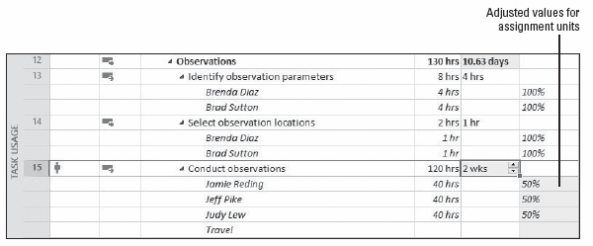
Step-by-Step: Change Values of the Work Formula
SAVE the project schedule.
PAUSE. LEAVE the project schedule open to use in the next exercise.
Notes:
Adjustments made after selecting Actions options on task 15

Slide 22
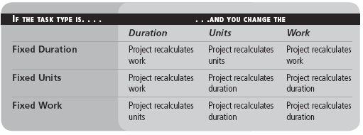
Changing Task Types
The following table highlights the effect of changing any scheduling formula variable for any task type.
Notes:
Take Note: To see the task type of a task you have selected, click the Information button on the Task ribbon, and then click the Advanced tab in the Task Information dialog box. You can also see the task type when you are in the Gantt Chart view via the Task Form. On the View ribbon, click Details in the Split View group. The Task form will appear in the lower portion of your screen.

Slide 23
Using the Task Information Dialog Box to Change a Task Type
In the previous exercise, you changed the way Project behaved (from its default action) by using the Actions button.
In the following exercise, you will change the task type using the Task Information dialog box and then change one of the values of units, duration, and work and allow the software to perform its normal actions.

Slide 24
Step-by-Step: Change a Task Type Using the Task Information Dialog Box
GET READY. USE the project schedule you created in the previous exercise.
Switch back to the Gantt Chart view by clicking on the Gantt Chart button in the View ribbon.
Press the F5 key. In the ID box, key 25 and then click OK.
Double‐click on task 25. The Task Information dialog box appears.
Click the Advanced tab if it is not already selected. Note that in the Task type box, the task has a Fixed Units task type. You need to adjust this task’s resources, but leave its duration fixed at 5 weeks.
Select Fixed Duration from the drop‐down menu in the Task type box.
Click the Resources tab in the Task Information dialog box.

Slide 25
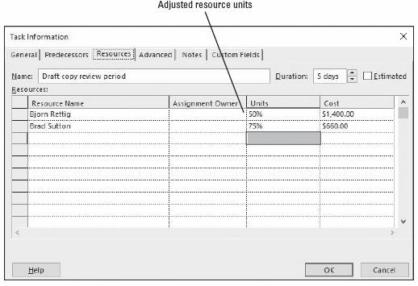
Step-by-Step: Change a Task Type Using the Task Information Dialog Box
In the Units column, set the units value for Bjorn Rettig to 50% and for Brad Sutton to 75%. Your screen should look similar to the figure below.
Notes:
Task Information dialog box showing adjusted resource units

Slide 26
Step-by-Step: Change a Task Type Using the Task Information Dialog Box
Click OK to close the Task Information dialog box. Note that the duration of the task did not change.
SAVE the project schedule.
PAUSE. LEAVE the project schedule open to use in the next exercise.
As you are fine‐tuning your project schedule, keep in mind that it is easy to confuse task type with effort‐driven scheduling. They are similar in that they both affect work, duration, and units values. The key difference is that effort‐driven scheduling affects your schedule only when you add or remove resources from tasks, whereas task type affects your schedule when you change the value of units, duration, or work.
Notes:
Take Note: You cannot change the task type on a summary task—it is always fixed duration. This is because the summary task is based on the earliest start date and the latest finish date of its subtasks.

Slide 27
Splitting a Task
Sometimes, work on certain tasks in a project schedule will stop and then start again, and these interruptions may be planned or unplanned.
You split a task to show that work has been interrupted and restarted.
A split is an interruption in a task, represented in Project’s Gantt bar by a dotted line between the two segments of the task.
In the next exercise, you will practice splitting a task to represent some nonworking time in the middle of the task.

Slide 28
Splitting a Task
Keep the following points in mind when splitting a task:
You can split a task into as many parts as necessary.
You can drag a segment of a split task either right or left to reschedule the split.
The time of the actual task split, represented by the dotted line, does not count in the duration of the task unless the task type is fixed duration. Work does not occur during the split.
If the duration of a split task changes, the last segment of the task is lengthened or shortened.
If a split task is rescheduled, the whole task, including the splits, is rescheduled. The same pattern of segments and splits is preserved.

Slide 29
Step-by-Step: Split a Task
GET READY. USE the project schedule you created in the previous exercise.
Select the name of task 11, Conduct focus groups.
Press the keystroke combination of CTRL + SHIFT + F5. Microsoft Project brings the Gantt bar of task 5 into view.
Click on the View tab. In the Zoom command group, in the selection box below Timescale, select days. Your screen should look similar to the figure on the next slide. Your team has decided to conduct these sessions in two distinct parts. The first part will begin on its currently scheduled start date of 1/16/19. The second part will begin on Monday 1/28/19.

Slide 30
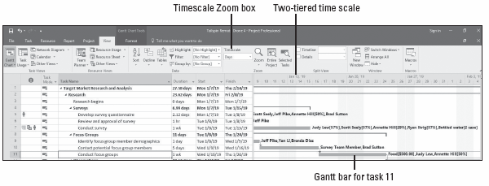
Step-by-Step: Split a Task
Right‐click on the Gantt bar for task 11. From the shortcut menu that appears, click the Split Task button from the upper shortcut menu. A ScreenTip appears and the mouse pointer changes to a double vertical line with an arrow to the right.
Notes:
Take Note: The timescale at the top of the right half of the Gantt chart (above the graphical bars) determines at what level of time (months, weeks, days, etc.) you can split a task. The calibration of the bottom tier of the timescale is the smallest increment into which you can split a task. In the following exercise, you can split a task into one‐day increments because days are on the bottom tier. If you wanted to split a task at the hourly level, you would need to adjust the Timescale option on the View ribbon.

Slide 31
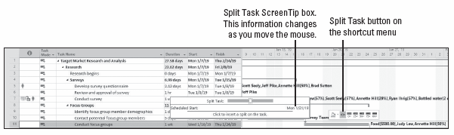
Step-by-Step: Split a Task
Move the mouse pointer over the Gantt bar of task 11. Watch the ScreenTip box as you move the pointer—the date changes. The ScreenTip box reflects the date on which you will begin to split the task. Your screen should look similar to the figure below.
Notes:
ScreenTip for splitting a task

Slide 32
Step-by-Step: Split a Task
Move (but don’t click) the mouse pointer over the Gantt bar until the start date of Monday, 1/21/19, appears in the ScreenTip box.
Click and hold, and then drag the mouse pointer to the right until the start date of Monday, 1/28/19, appears in the ScreenTip, and then release the mouse button.
Microsoft Project inserts a task split between the two parts of the task. The split, or interruption in work, is represented by a dotted line in the Gantt chart, as shown in the figure on the next slide.
Notes:
Take Note: Splitting tasks using the mouse pointer takes a little practice. If you split a task on the wrong date, there are two ways you can correct it. First, you can click the Undo button on the menu bar to remove the incorrect split. Or, point to the second segment of the task again, and when the mouse pointer changes to a circle with four arrows, drag the segment to the correct start date. You can drag multiple times.

Slide 33
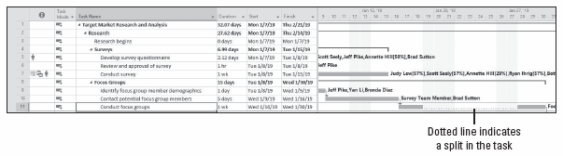
Step-by-Step: Split a Task
SAVE the project schedule.
PAUSE. LEAVE the project schedule open to use in the next exercise.
Notes:
Resource leveling or manually contouring assignments can also cause tasks to split. You can learn more about resource leveling in Lesson 6 and about contouring assignments in Lesson 13.

Slide 34
Establishing Recurring Tasks
Many projects require repetitive tasks, such as a status meeting or cleaning a production line. Even though these might seem like negligible tasks, you should account for them in your project schedule because they require time from project resources and, therefore, have costs associated with them.
A recurring task is a task that is repeated at specified intervals, such as daily, weekly, or monthly. When you create a recurring task, Microsoft Project creates a series of tasks with Start No Earlier Than constraints, no task relationships, and effort‐driven scheduling turned off.
In the following exercise, you will learn how to set up a task that will repeat at a specified interval during the project.

Slide 35
Step-by-Step: Set Up a Recurring Task
GET READY. USE the project schedule you created in the previous exercise.
Select the blank name cell under task 55, Project Management. You want to insert the recurring tasks as the first item in the Project Management phase.
On the Task ribbon, in the Insert group, click the down arrow under the Task button. Select Recurring Task. The Recurring Task Information dialog box appears.
In the Task Name box, key Status Meeting.
In the Duration box, key 1 h.
Under Recurrence Pattern, make sure that Weekly is selected, a 1 is in the Recur every box, and then select Monday.

Slide 36
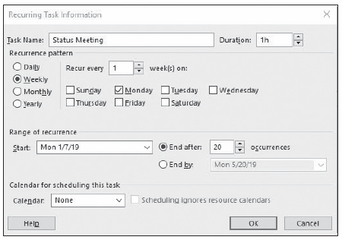
Step-by-Step: Set Up a Recurring Task
In the Start box, key or select 1/7/19. The first occurrence of your weekly meeting will be on January 7, 2019.
Under Range of Recurrence, select End after, and then key or select 20 occurrences. Your screen should look like the figure below.
Notes:
Take Note: Microsoft Project schedules a recurring task to start at the Default Start Time value you established at the beginning of your project. To schedule a recurring task to begin at a different time, enter that time along with the start date in the Start box of the Recurring Task Information dialog box. For instance, if you want the status meeting to start at 9:00 a.m. on January 7, you would enter 1/7/19 9 AM in the Start box.

Slide 37
Step-by-Step: Set Up a Recurring Task
Click OK to create the recurring task. A Microsoft Project dialog box appears to notify you that one of the instances of the recurring task will occur during nonworking times (the holiday on January 21).
Review the options presented in the dialog box. You want to reschedule the status meeting for this particular week. Click Yes to reschedule this occurrence of the task. Microsoft Project inserts the recurring tasks within the Project Management phase. A recurring task icon appears in the Indicators column, as shown in the figure on the next slide.

Slide 38
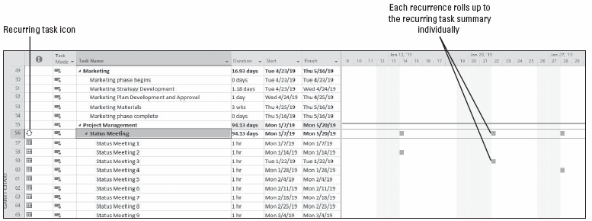
Step-by-Step: Set Up a Recurring Task
Notes:
Gantt chart showing expanded recurring task

Slide 39
Step-by-Step: Set Up a Recurring Task
You now need to indent the status meeting tasks under the Project Management task. Select the name cell of task 56, Status Meeting.
On the ribbon, select the indent button.
On the Task ribbon, in the Editing group, click the Scroll to Task button. The Gantt chart displays the first occurrences of the recurring meeting’s Gantt bars. Notice that the Gantt bar at the recurring task level (task 56) task shows only the individual occurrences of the tasks. This is because a recurring task is not a true summary task.
SAVE the project schedule.
PAUSE. LEAVE the project schedule open to use in the next exercise.

Slide 40
Assigning Resources to a Recurring Task
Keep the following points in mind when establishing a recurring task:
You can only use the Assign Resources dialog box when assigning resources to all recurring tasks at the same time. If you enter resource names in the Resource Name field of the summary task, the resources will only be assigned to the summary task, not to the individual occurrences.
If you schedule a recurring task to end on a specific date, Microsoft Project will suggest the current project end date. If you select the project end date, you will need to manually change it later if the project end date changes.
As you learned in this exercise, Microsoft Project will alert you if an occurrence of a recurring task will take place during nonworking time. You can choose to skip that occurrence or to schedule it for the next working day.
Notes:
In the previous exercise, you established a recurring task in your project schedule. In the following exercise, you will assign resources to it.

Slide 41
Step-by-Step: Assign Resources to a Recurring Task
GET READY. USE the project schedule you created in the previous exercise.
If it is not already selected, click on the name of task 56, Status Meeting.
Click the Resource tab. In the Assignments group on the ribbon, click Assign Resources.
In the Assign Resources dialog box, click Brad Sutton. Then hold down Ctrl while clicking Eva Corets, Florian Voss, Jane Clayton, and Judy Lew.
Click Assign and then click Close. Microsoft Project assigns the selected resources to the recurring task.
If the recurring task is not already expanded, click the expand button next to task 56’s title to show the subtasks. Your screen should look similar to the figure on the next slide.

Slide 42
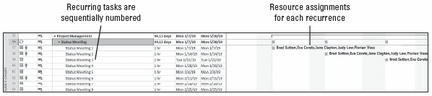
Step-by-Step: Set Up a Recurring Task
Click the collapse button next to task 56’s task title to collapse the subtasks under the recurring task.
SAVE the project schedule.
PAUSE. LEAVE the project schedule open to use in the next exercise.
Notes:
Gantt chart displaying resource assignments on recurring tasks

Slide 43
Applying Task Constraints
Every task that you enter into your project schedule has some type of limit, or constraint, applied to it.
The constraint controls the start or finish date or the extent to which the task can be adjusted. There are three categories of constraint, and each has very different effects on the scheduling of tasks.
A flexible constraint gives Project the ability to change start and finish dates (this is the default type).
An inflexible constraint forces a task to begin or end on a specific date, and should be used only when necessary.
A semi‐flexible constraint gives Project the ability to change task start and finish dates (but not duration) within one date boundary.

Slide 44
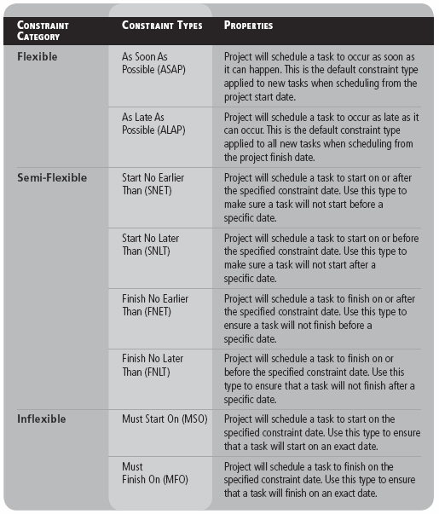
Applying Task Constraints
The table at right shows the eight types of task constraints within the three constraint categories.
Notes:
Constraint categories and constraint types

Slide 45
Applying a Constraint to a Task
Keep the following points in mind when setting constraints for tasks:
To remove a constraint, double‐click on the task you want to remove the constraint from. In the Task Information dialog box, click the Advanced tab. In the Constraint Type box, select As Soon As Possible (if scheduling from the start date) or As Late As Possible (if scheduling from the finish date).
If you try to apply inflexible or semi‐flexible constraints to tasks in addition to task links, you might create what is known as negative float—or negative slack—the amount of time that tasks overlap due to a conflict between task relationships and constraints. To set Microsoft Project to honor relationships over constraints, select the File tab, click Options, and then click the Schedule option. Under Schedule Options for this project, clear the Tasks will always honor their constraint dates check box.

Slide 46
Applying a Constraint to a Task
Keep the following points in mind when setting constraints for tasks (continued):
Some constraint behaviors change if you must schedule a project from a finish date rather than a start date. For instance, the ALAP constraint type becomes the default for new tasks, rather than ASAP. Pay close attention to the constraints you apply in this case to make sure the results are what you expected.
It is considered a best practice to insert a note on any task that has a constraint applied. The reasoning for this is simple—communication. By entering a note, anyone who views the schedule will see why a constraint is applied. In Lesson 1, you learned how to insert a note on a task.
Notes:
In the following exercise, you will apply a Start No Earlier Than constraint to a task in Microsoft Project.

Slide 47
Step-by-Step: Apply a Start No Earlier Than Constraint to a Task
GET READY. USE the project schedule you created in the previous exercise.
Press the F5 key. In the ID box, key 38 and press Enter. This task represents the testing of the remote drone and the testing field will not be available until March 18, 2019.
Double‐click on task 38. The Task Information dialog box appears.
Click on the Advanced tab. In the Constrain task section, next to Constraint type, select Start No Earlier Than from the drop‐down box.
In the Constraint date box, key 3/18/19. Your screen should look similar to the figure on the next slide.
Notes:
Take Note: Unless you specify otherwise, Microsoft Project schedules the start or finish time of a constraint date using the Default Start Time or Default End Time value you established at the beginning of your project (on the ribbon, click File, select Options, and then click the Schedule section).

Slide 48
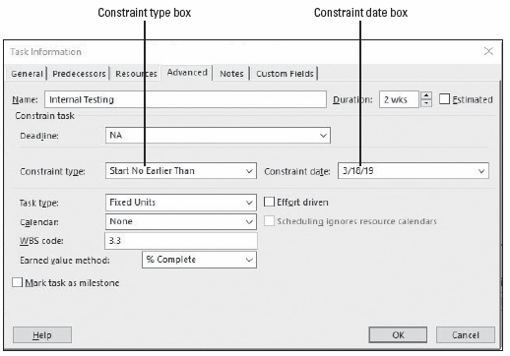
Step-by-Step: Apply a Start No Earlier Than Constraint to a Task
Click OK. Note the highlighted cells showing the effect of this change. Widen the table as necessary to view the Start and Finish columns.
SAVE the project schedule.
PAUSE. LEAVE the project schedule open for the next exercise.
Notes:
Take Note: Avoid entering task start and finish dates unless absolutely necessary. When you enter start or finish dates, Project applies semi‐flexible constraints such as Start No Earlier Than or Finish No Earlier Than, which prevents the project manager from taking advantage of the Microsoft Project scheduling engine.

Slide 49
Using the Task Inspector
Another feature in Microsoft Project 2016 that is helpful in reviewing constraints, assignments, and dependencies is the Task Inspector.
The Task Inspector looks at the task drivers and shows the factors that drive a task’s start times and helps you backtrack to analyze the constraints.
You can use the Task Inspector to determine the factor(s) driving the start date of a task or follow a chain of factors to find the cause of a delay you are tracking.
You can access Task Inspector by clicking on the Task ribbon and then clicking on Inspect in the Tasks group. The Task Inspector pane will appear on the left side of your screen.
The figure that appears on the next slide shows the Task Inspector pane activated for task 7.

Slide 50
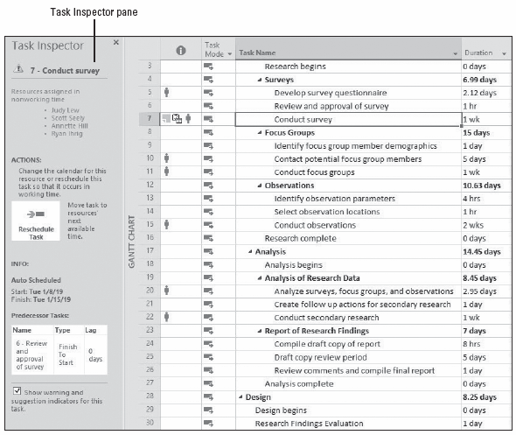
Using the Task Inspector
Notes:
Task Inspector pane activated for task 7

Slide 51
Reviewing the Project’s Critical Path
In every project, there is a series of tasks, known as the critical path, that directly affect the finish date of the project. If any one of these tasks is delayed, either at the start or completion of, the finish date of the project will be delayed.
The term critical refers not to the importance of the tasks in the critical path, but rather to the impact that the scheduling of these tasks has on the finish date of the project.
One of the best ways to shorten the overall duration of a project is to shorten its critical path. In Project 2016, you can review your project’s critical path, including any existing free slack—the amount of time a task can be delayed before it will delay another task.
In the next exercise, you will review your project’s critical path.

Slide 52
Reviewing the Project’s Critical Path
To fully understand the critical path concept, there are a few other terms with which you need to become familiar. Microsoft Project uses the term slack for the term float.
Float (or slack) is the amount of time a task can be delayed without causing a delay to another task or the overall project.
Free Float (or free slack) is the amount of time a task can be delayed before it will delay another task.
Total float (or total slack) is the amount of time a task can be delayed without delaying the project end date.
A task is usually considered to be on the critical path if its total float is zero. Conversely, noncritical tasks have float greater than zero. Their start or finish dates can vary within their slack amounts without affecting the finish date of the project.

Slide 53
Step-by-Step: Review the Project’s Critical Path
GET READY. USE the project schedule you created in the previous exercise.
Click the Task tab, and then click the down arrow under the Gantt Chart button; the view list appears. Select More Views.
In the More Views dialog box, locate and select Detail Gantt, and then click the Apply button. The project schedule is displayed in the Detail Gantt view.
Click the View tab. In the Zoom command group, click the Zoom Entire Project button.
Press the F5 key. The Go To dialog box appears. In the ID box, key 30, and then click OK. The view shifts so that the Gantt bar for task 30 is visible. Scroll down so that most of the tasks after task 38 are visible, and you can see more of the critical path. Your screen should look similar to the figure on the next slide.
Notes:
All of the tasks that fall after task 38, Internal testing, are on the critical path, which is shown in red. Noncritical tasks are displayed in blue and also show slack. (Slack is shown as the thin bar that extends to the right of the task bar.)

Slide 54
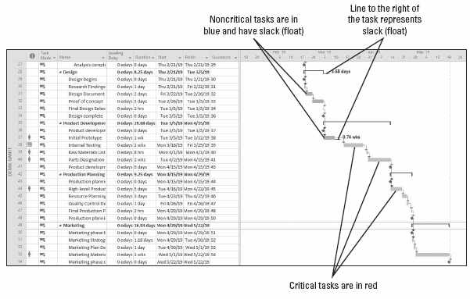
Step-by-Step: Review the Project’s Critical Path
SAVE the project schedule.
PAUSE. LEAVE the project schedule open for the next exercise.
Notes:
Gantt chart showing the critical path starts at task 38

Slide 55
Viewing Resource Allocations Over Time
As a project manager, you are responsible for distributing work among the people and equipment resources of the project.
Allocation is the portion of a resource’s capacity devoted to work on a specific task. Allocation is how you manage these resources and their assignments over time.
You need to be able to review each resource’s allocation, identify any problems that are evident, and adjust allocations as needed.
In the following exercise, you will review your resources to identify resource allocation issues.

Slide 56
Reviewing Resource Allocations
As the project manager, the decisions you make regarding task assignments affect the workloads of project resources. Every resource is in one of three states of allocation:
Underallocated: The work assigned to a resource is less than the resource’s maximum capacity. A full‐time resource who has only 20 hours of work assigned in a 40‐hour workweek is underallocated.
Fully allocated: The condition of a resource when the total work of its task assignments is exactly equal to that resource’s work capacity. For example, a full‐time resource assigned to work 40 hours per week is fully allocated.
Overallocated: The work assigned to a resource is more than the resource’s maximum capacity. A full‐time resource who has 55 hours of work assigned in a 40‐hour workweek is overallocated.

Slide 57
Reviewing Resource Allocations
Keep the following points in mind when reviewing resource allocation:
In the Resource Usage view, the default table is the Usage table. You can display other table views by clicking the View tab, then clicking Usage in the Table command group and selecting the table you want to display.
Work values are the default in the time‐scaled grid of the Resource Usage view. To display other assignment values, such as cost, click the Format tab, click Details, and then select the value you want to display.
Notes:
Allocating resources takes a combination of skill and common sense. It might seem straightforward to say that all resources should be fully allocated all of the time, but this is not always possible, practical, or even desirable. There are situations in which overallocation or underallocation is quite acceptable. As the project manager, you must learn how to identify allocation problems and how to handle them.

Slide 58
Step-by-Step: Explore Resource Allocations
GET READY. USE the project schedule you created in the previous exercise.
On the Task ribbon, in the View group, click the down arrow under the Gantt Chart button. Select More Views.
In the More Views dialog box, locate and select the Resource Allocation view. Click Apply. A split view appears: The Resource Usage view is on the top and the Leveling Gantt Chart view is on the bottom.
Click once on the Resource Name column heading to highlight all cells in that field.
Click the View tab. In the Data group, click the Outline button, and then select Hide Subtasks. Microsoft Project collapses the assignments in the Resource Usage view. Your screen should look similar to the figure on the next slide.

Slide 59
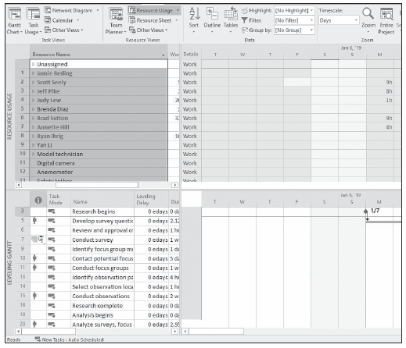
Step-by-Step: Explore Resource Allocations
Notes:
Split view—the Resource Usage (top) with Resource Name field selected and the Leveling Gantt (bottom)

Slide 60
Step-by-Step: Explore Resource Allocations
In the Resource Name column, click the task name cell Jamie Reding.
Press the keystroke combination of CTRL + SHIFT + F5. The resources’ total work values over the project timescale appear in the grid on the right. Your screen should look similar to the figure on the next slide.
On the left side of the Resource Usage view is the Usage Table, which shows the assignments grouped by resource, the total work assigned to each resource, and the work for each assignment. The outline format can be expanded and collapsed. The right side of the view contains assignment details (default setting is work) displayed on a timescale.

Slide 61
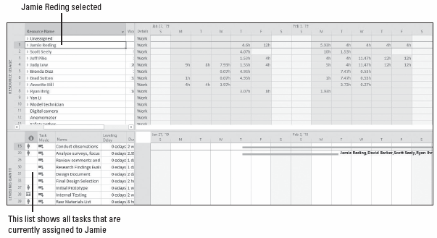
Step-by-Step: Explore Resource Allocations
Notes:
Resource Allocation view with assignments collapsed

Slide 62
Step-by-Step: Explore Resource Allocations
Auto‐fit the Resource Name and Work columns. Then, in the Resource Name column, click on the name of resource 3, Jeff Pike. Note at the bottom of the screen, the Leveling Gantt view shows the actual tasks to which Jeff is assigned.
Click the View tab. In the Zoom group, click the down arrow next to the timescale units box and select Months. The time‐scaled grid now shows work values per month. Your screen should look similar to the figure on the next slide.
SAVE the project schedule. CLOSE the project schedule.
PAUSE. If you are continuing to the next lesson, keep Microsoft Project open. If you are not continuing to additional lessons, close Microsoft Project.
Notes:
Don’t worry if you see a resource group titled Unassigned. Sometimes, there are tasks that have no specific resources assigned to them. These tasks are grouped together in this view and listed as a resource named Unassigned.
Another Way: Instead of using the Timescale command to change the tiers of the timescale, you can click the Zoom slider located at the lower right of your screen. If this method doesn’t give you the level of detail you need, you can use the Timescale command.

Slide 63
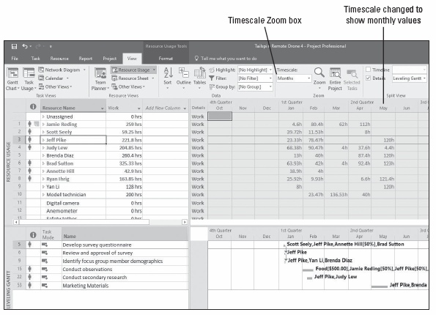
Step-by-Step: Explore Resource Allocations
Notes:
Time‐scaled grid showing monthly work assignment values

Slide 64
Skill Summary

